Slide 1
Management & Conservation Strategies
© R. KYES
Ecosystem Management
Breeding Programs
Rehabilitaton & Reintroduction Programs
Community Outreach Programs

Slide 2
Breeding Programs
© R. KYES
Breeding Programs represent an important conservation strategy.
Where: Zoos, Universities, Research Centers, etc.
Types of breeding programs: captive breeding, natural habitat breeding
Objectives:
1. To ensure the existence of endangered species that are on the verge of extinction.
2. To facilitate the re-establishment of populations in the wild via reintroduction.
3. To ensure animal resources for research (thus eliminating capture from wild populations.

Slide 3
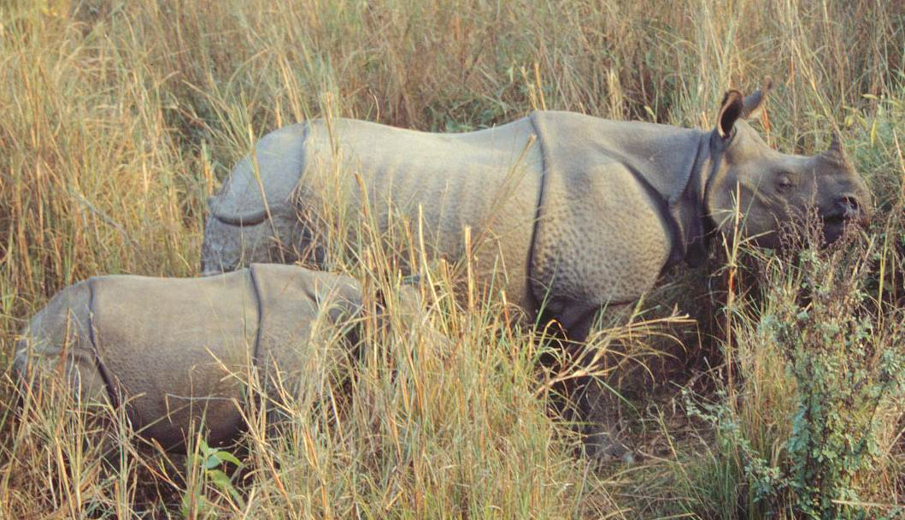
Breeding Programs
1. To ensure the existence of endangered species
Example: Zoos
Endangered Species Breeding Programs (captive setting, using new assisted reproduction techniques).
Provide a genetic resource of endangered species
Taman Safari (Bogor) - ex. Tiger, Rhinos
Woodland Park Zoo - ex. Sun Bears
San Diego Zoo - ex. Panda Bears

Slide 4
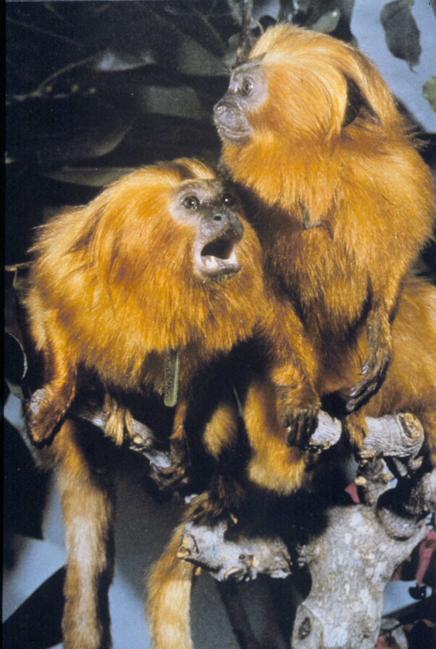
Breeding Programs
2. To facilitate the re-establishment of wild populations via (re)introduction
Example: Tigers, Golden Lion Tamarin, Owa

Slide 5
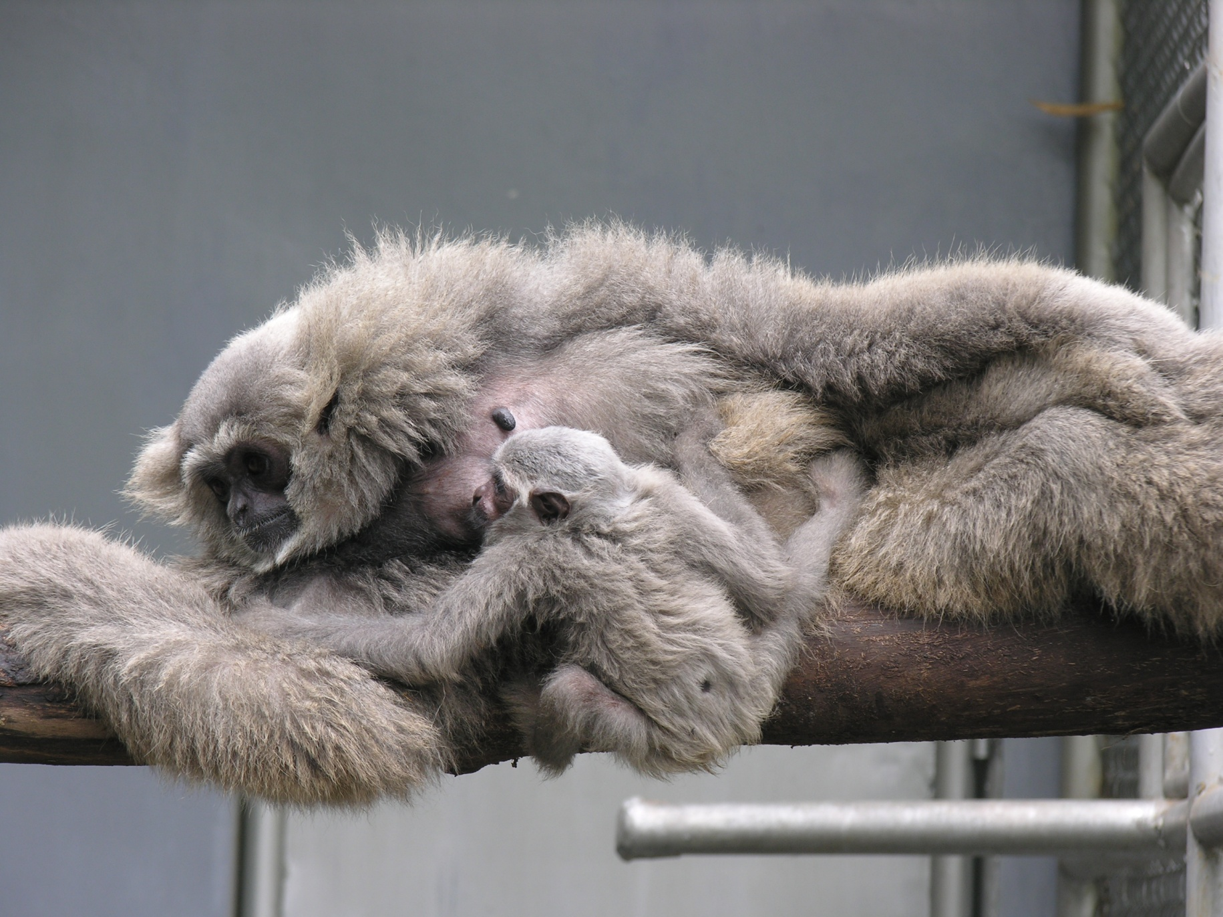
Breeding Programs
2. To facilitate the re-establishment of wild populations via (re)introduction
Example: Tigers, Golden Lion Tamarin, Owa (Javan Gibbon)
Point of debate: low survivability and neglect of natural populations

Slide 6
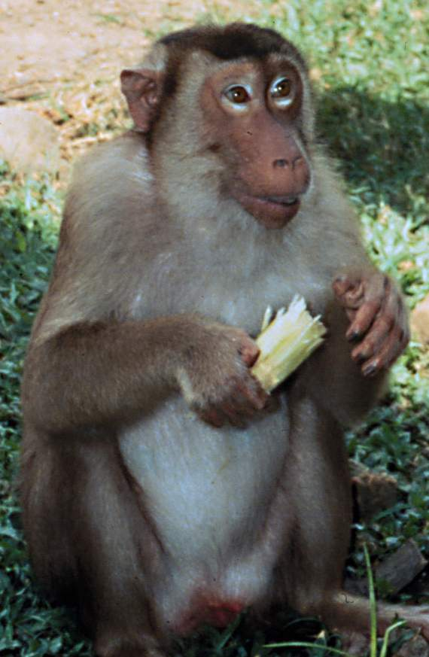
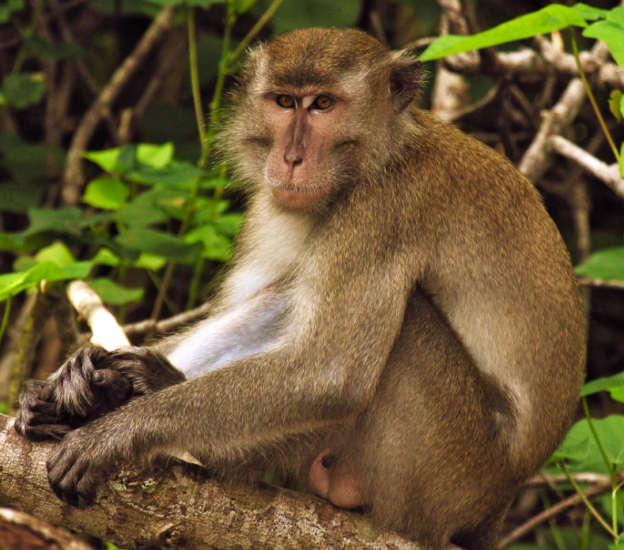
Breeding Programs
3. To ensure animal resources for research
Example: University/Research Centers
Primate Research Centers at the:
- University of Washington
- Institut Pertanian Bogor, Indonesia
Primate Models for Biomedical Research

Slide 7
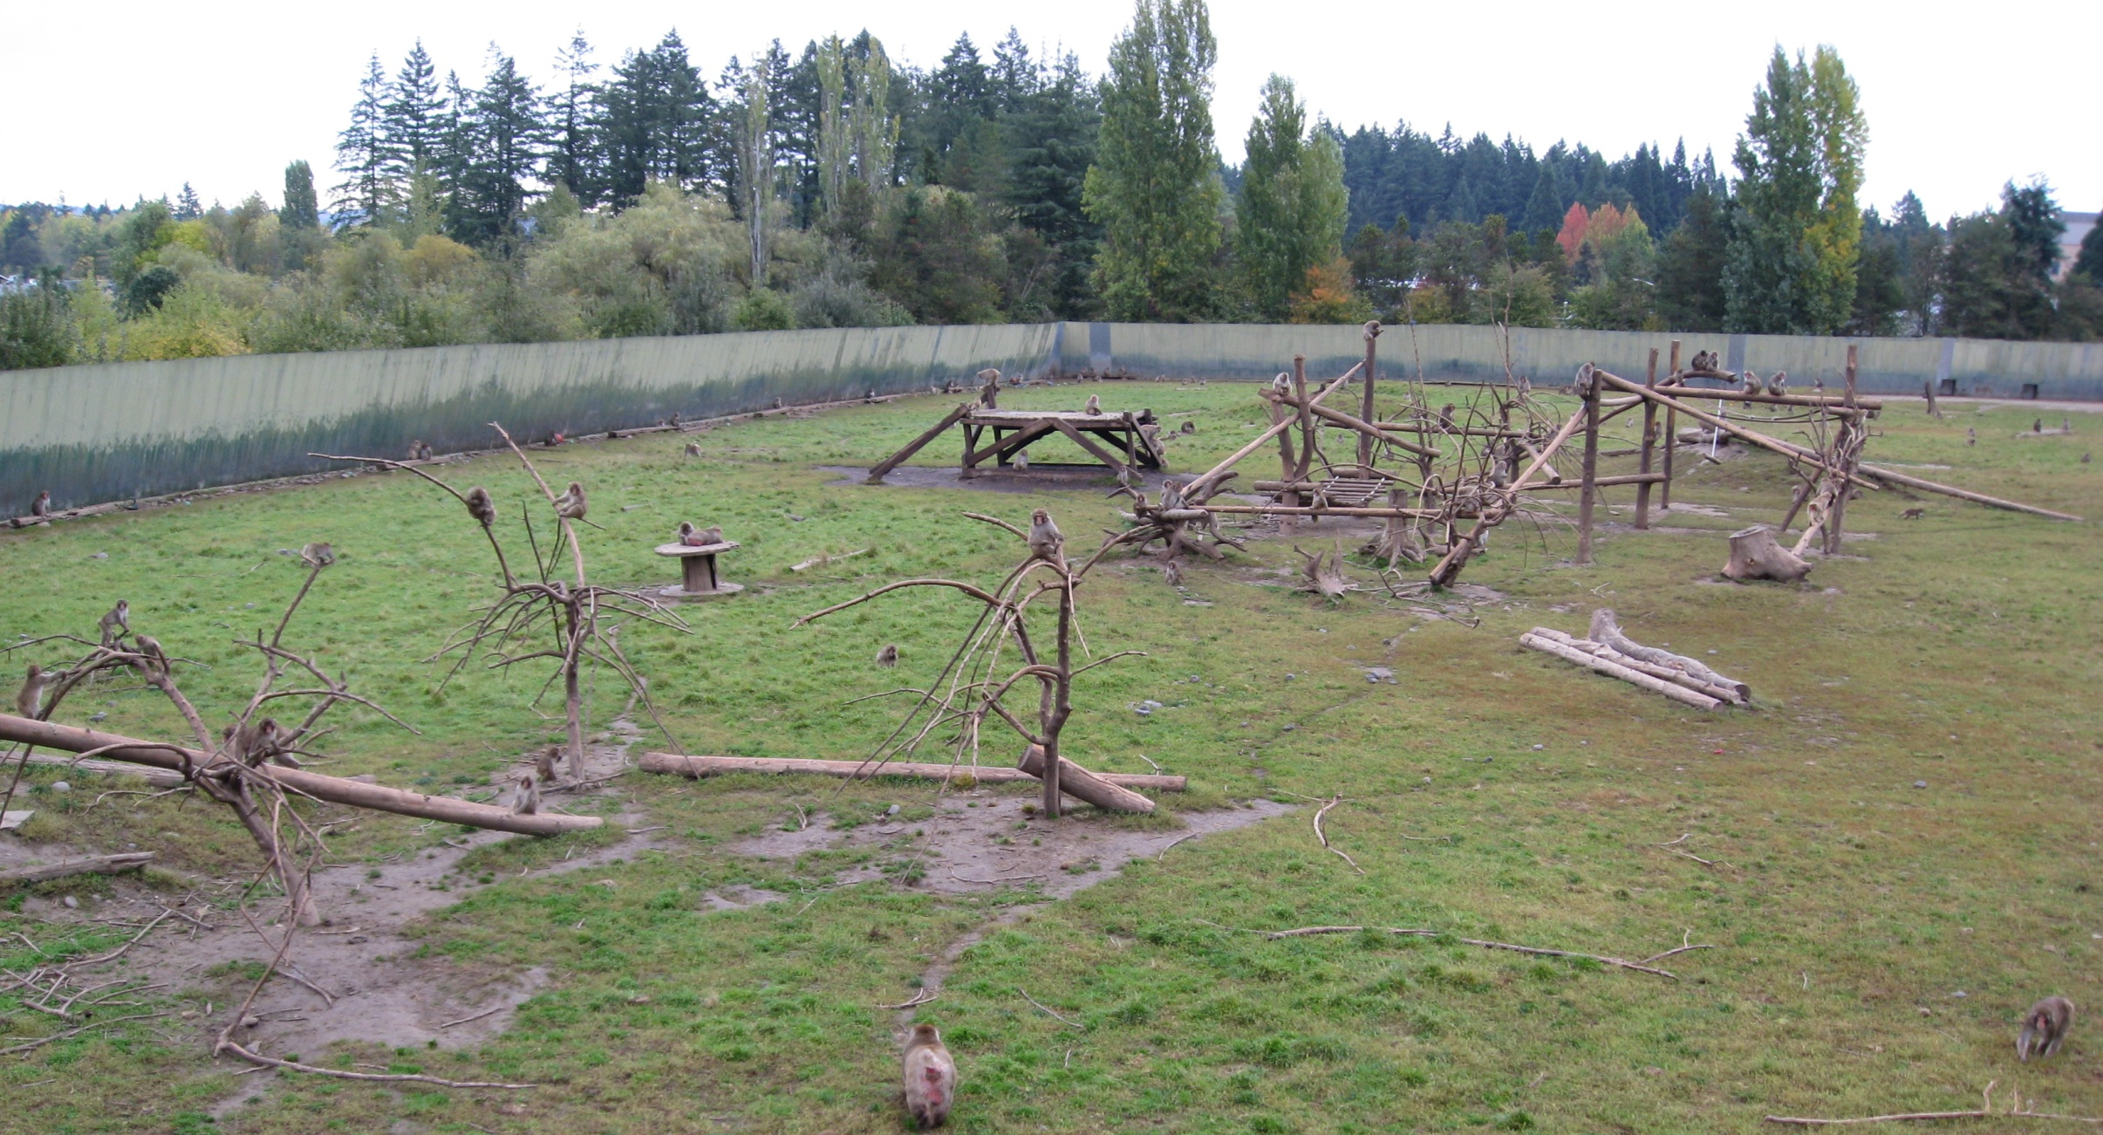
Breeding Programs
Captive Breeding Facilities:

Slide 8
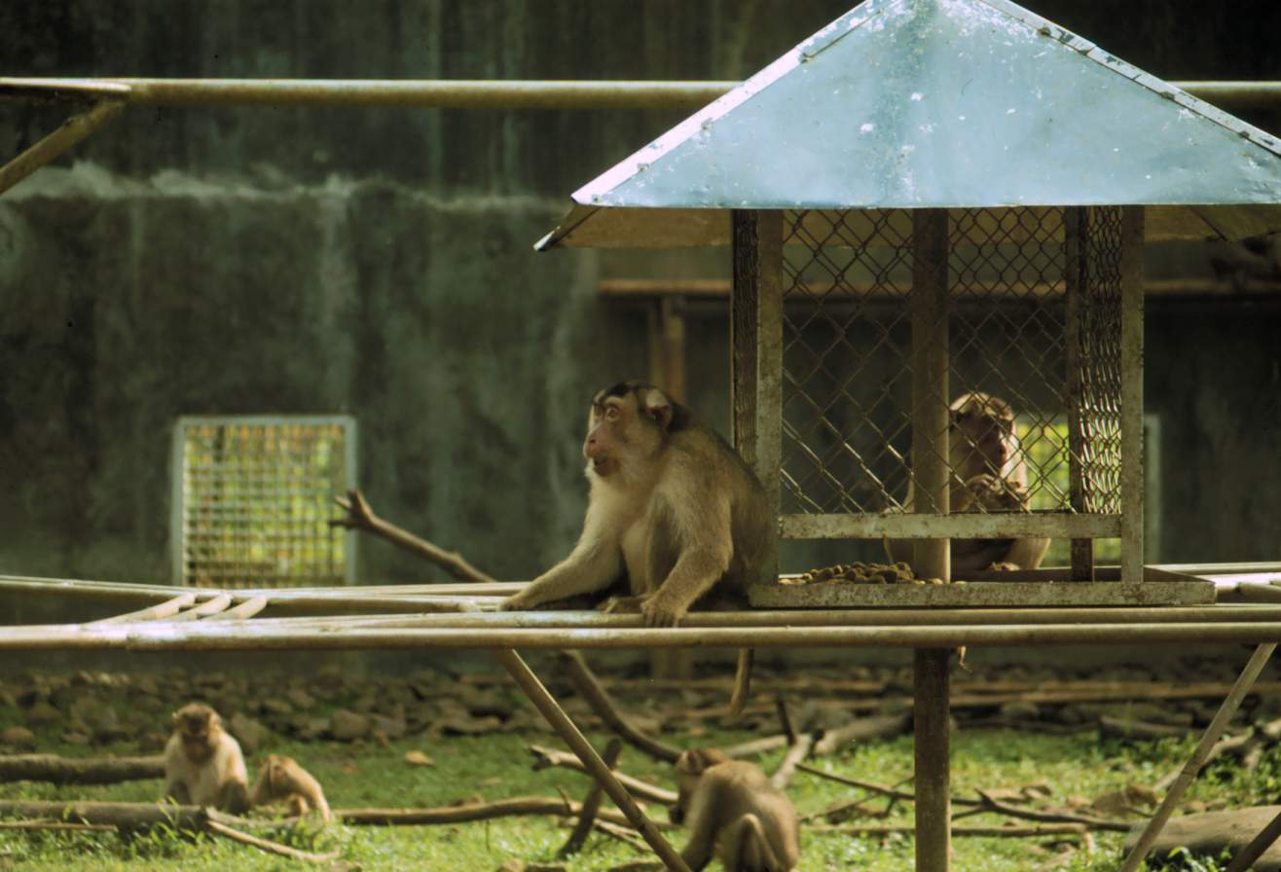

Breeding Programs
Captive Breeding Facilities:

Slide 9
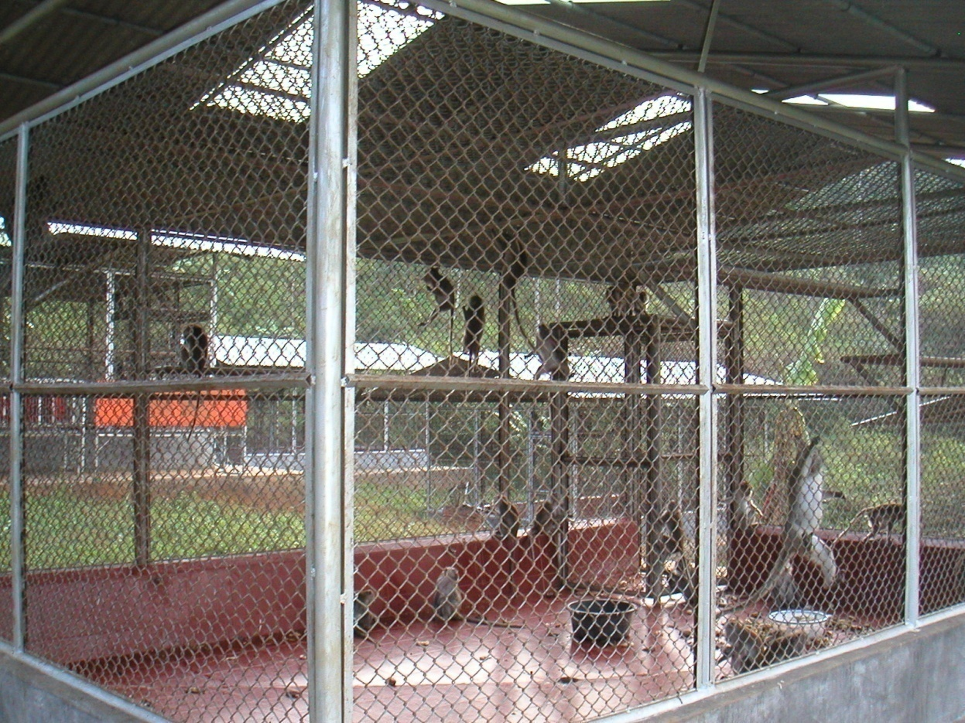
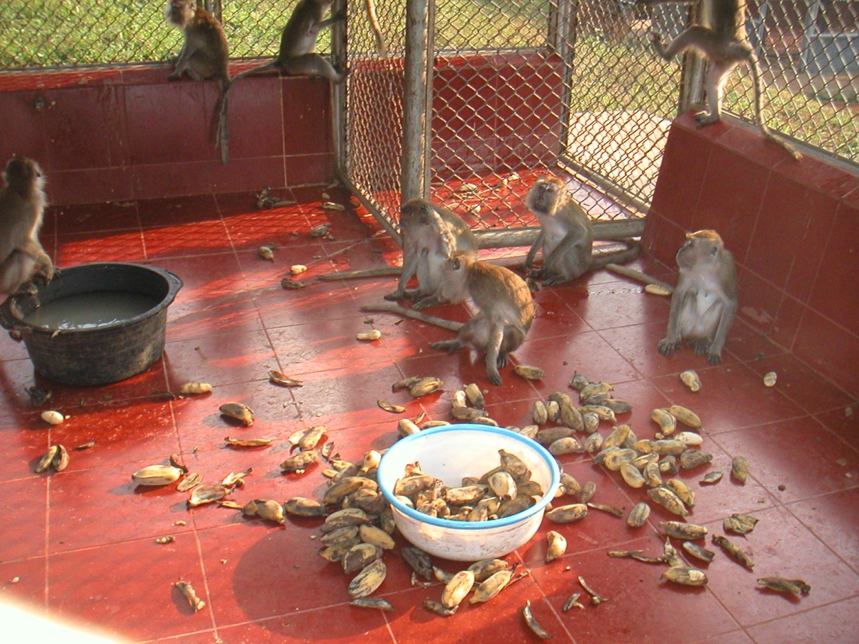
Breeding Programs
Captive Breeding Facilities:

Slide 10
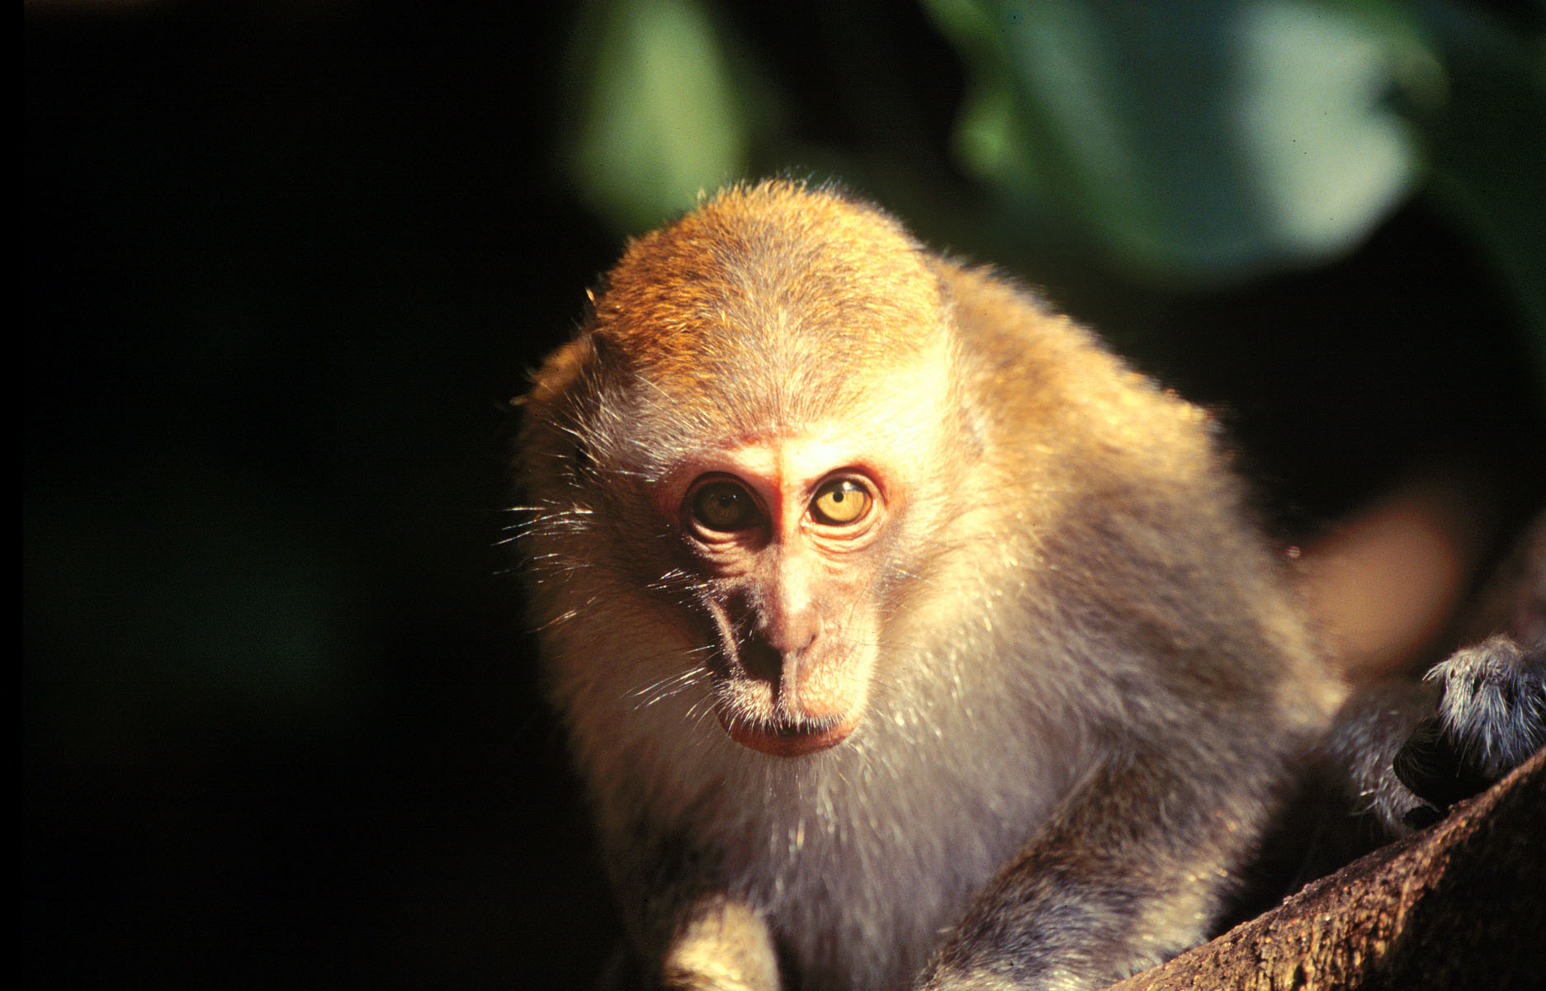
Tinjil Island Natural Habitat Breeding Facility: Considerations for Natural Habitat Breeding

Slide 11
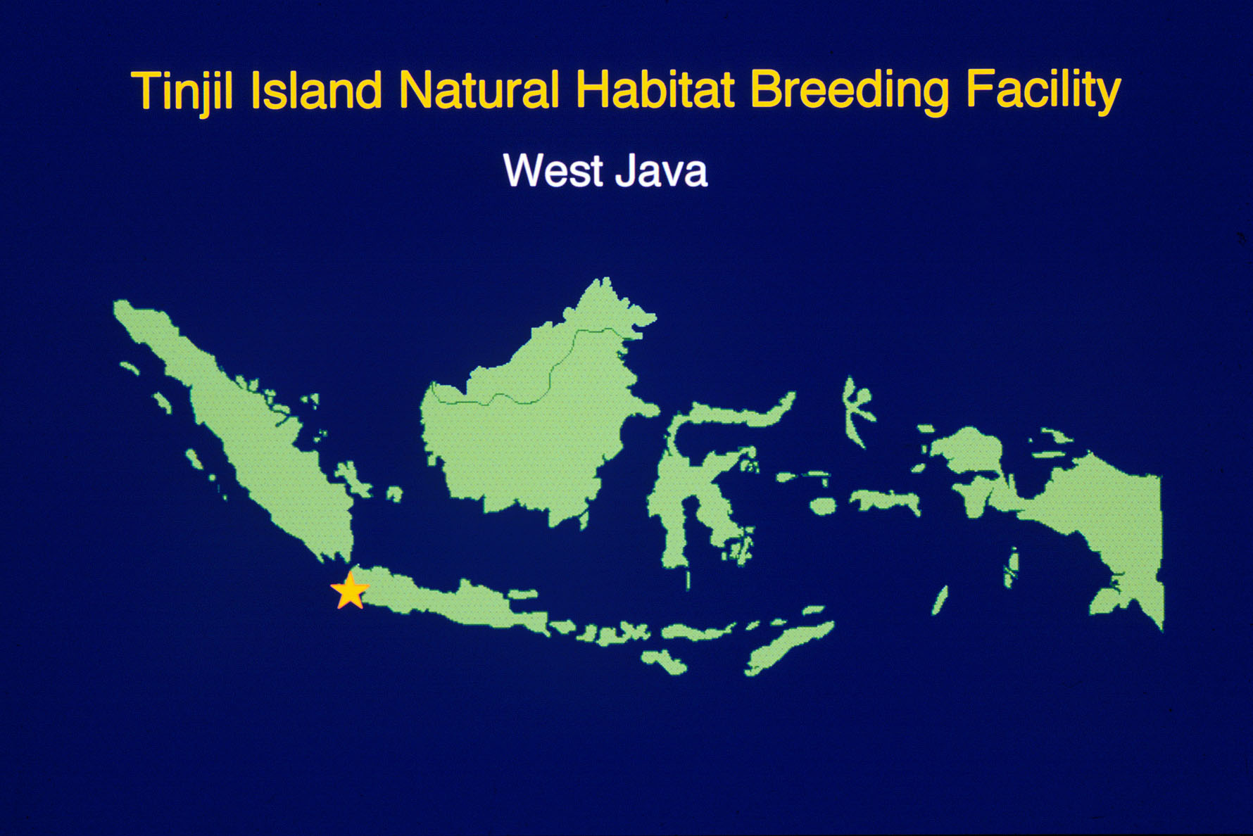
West Java, Indonesia

Slide 12
Small islands, representative of a species’ native environment, are especially suitable for establishing natural habitat breeding facilities (NHBFs).
Using the natural boundary provided by an island, an introduced group of animals can be managed as a free-ranging population in relative isolation under natural conditions.

Slide 13
Key Benefits of a natural habitat island
Free-ranging - promotes natural behavior, etc.
Relative isolation - minimizes risk of pathogen transmission, etc.
Natural conditions (native foods, weather conditions, etc.) -
conducive to the animals’ general health
and well-being.
Economical - compared to more traditional captive facilities
(e.g., no provisioning, minimal facility costs, etc.).

Slide 14
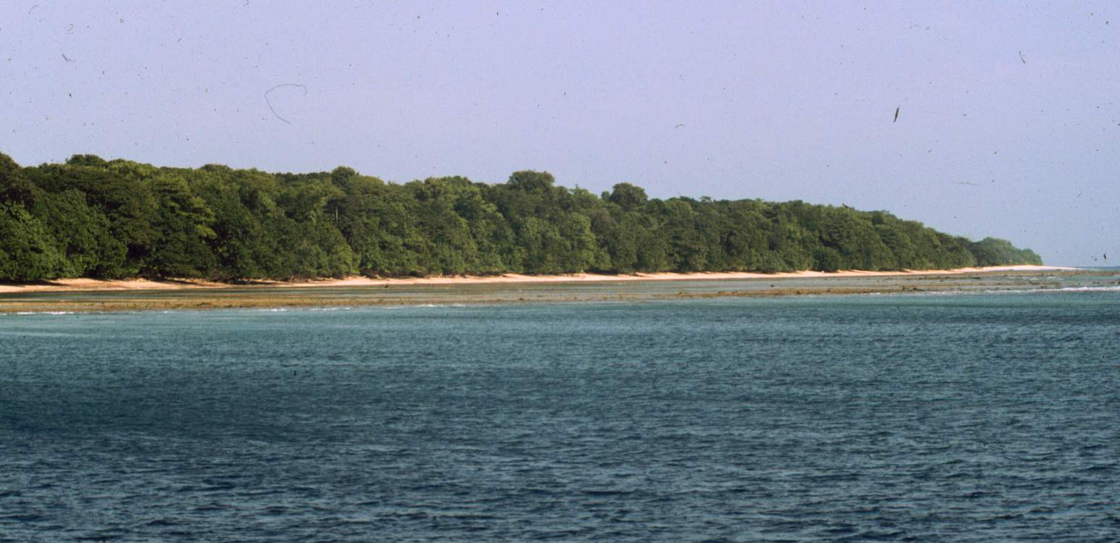
Considerations for selecting an island as a natural habitat breeding facility or sanctuary
Suitable Habitat (Natural food/water sources, competitors, predators)
Accessibility and Logistical Support
Impact on Existing Ecosystem
Security
Population Management

Slide 15
West Java, Indonesia

Slide 16
Tinjil Island Natural Habitat Breeding Facility
Established: November 1987
Developed through the collaboration between
the U.S. Primate Research Consortium and the
Bogor Agricultural University (IPB), Indonesia.
Purpose: To serve as a primate resource and conservation
program - to provide monkeys (Macaca fascicularis)
for biomedical research (e.g., AIDS, heart disease,
etc.) while contributing to Indonesia’s primate
conservation efforts.

Slide 17
The concept for the Tinjil Island NHBF originated, in part, from a 1981 meeting convened by the World Health Organization (WHO) to address the feasibility of establishing national programs in habitat countries to help manage primate populations as sustainable or “renewable” resources.
The objective: to ensure the permanent conservation of the various species and maintain the supply of primates for essential biomedical research.

Slide 18
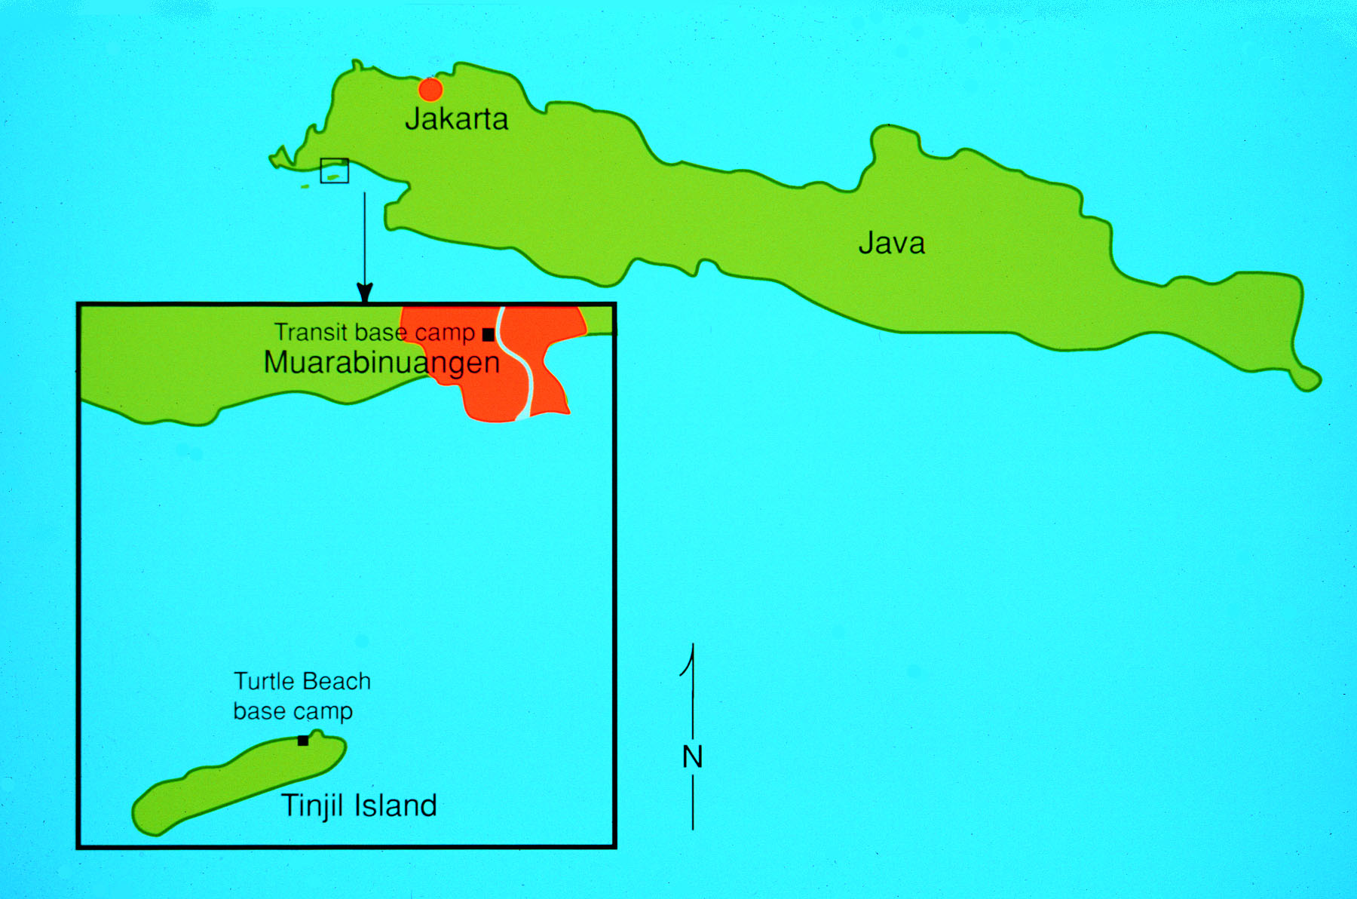
Tinjil Island NHBF - Background Information
Tinjil Island is approximately 600 ha in size and is located
16 km off the south coast of West Java.
The island consists
of lowland tropical
rainforest and coastal
vegetation.

Slide 19
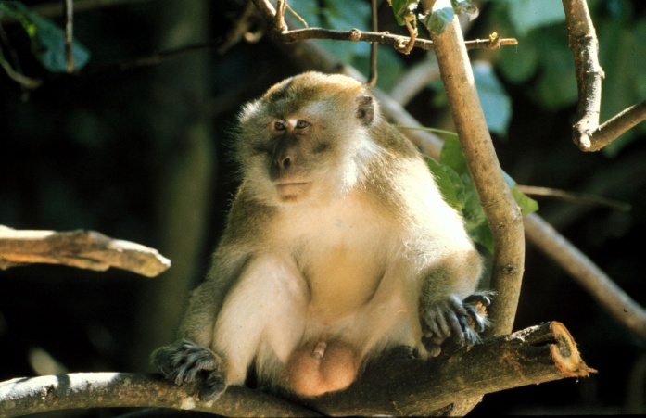
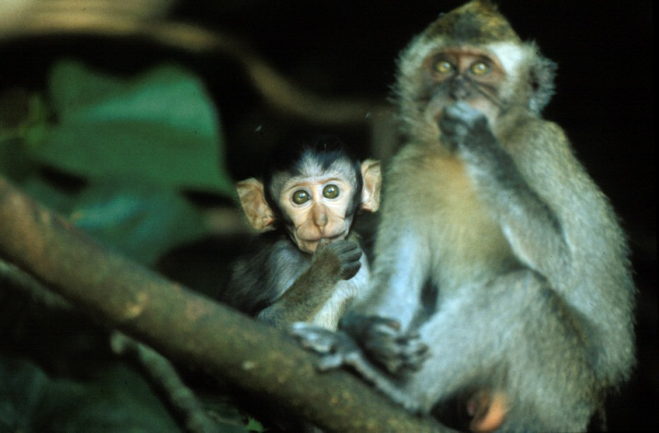
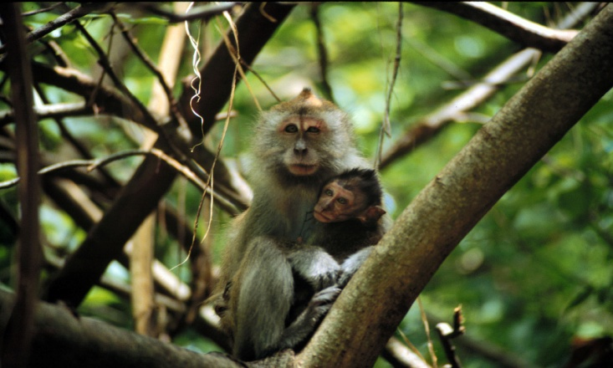
Tinjil Island NHBF - Background Information
Between 1988 and 1994, 520 adult
longtailed macaques (M. fascicularis)
were released onto Tinjil Island.
To date, >3000 progeny have been
removed from the island for use
in biomedical research (AIDS,
malaria, dengue fever, etc.).
The current population size is
estimated at 1300 monkeys.

Slide 20
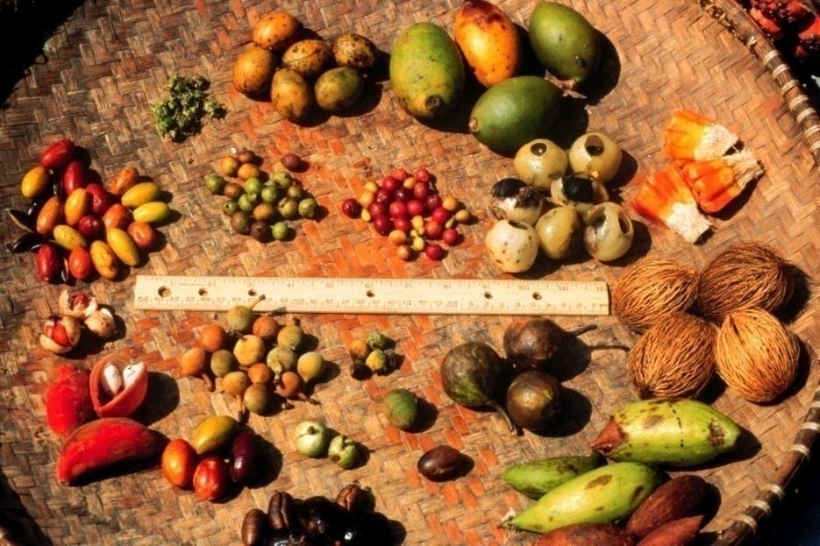
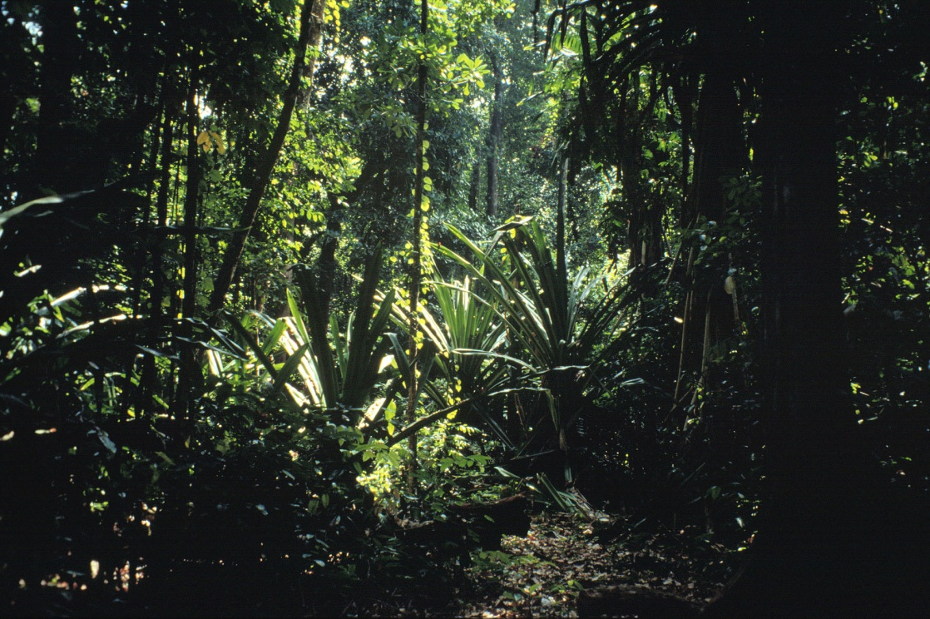
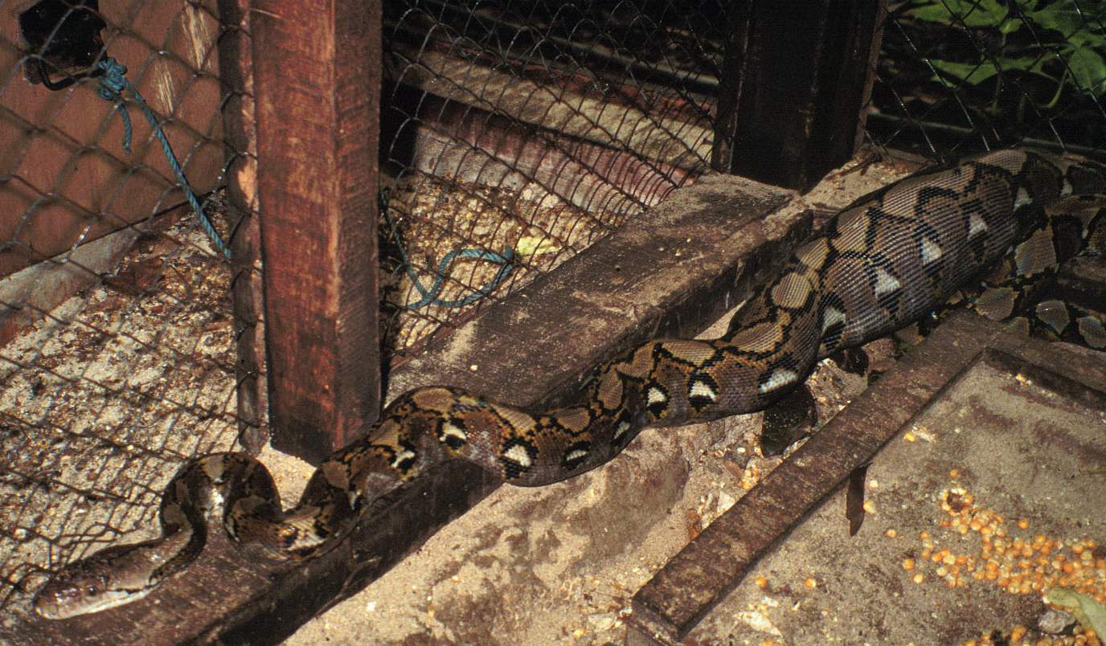
Considerations for selecting an island as a natural habitat breeding facility or sanctuary
Suitable Habitat (Natural food/water sources, competitors, predators)

Slide 21
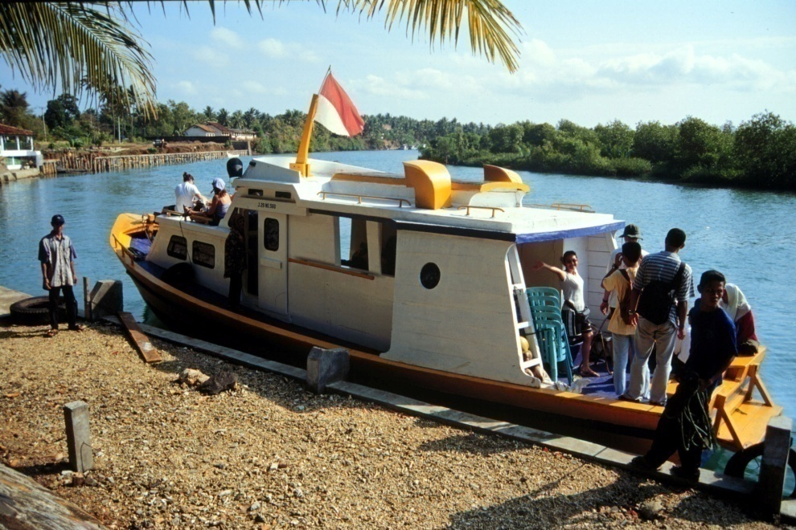
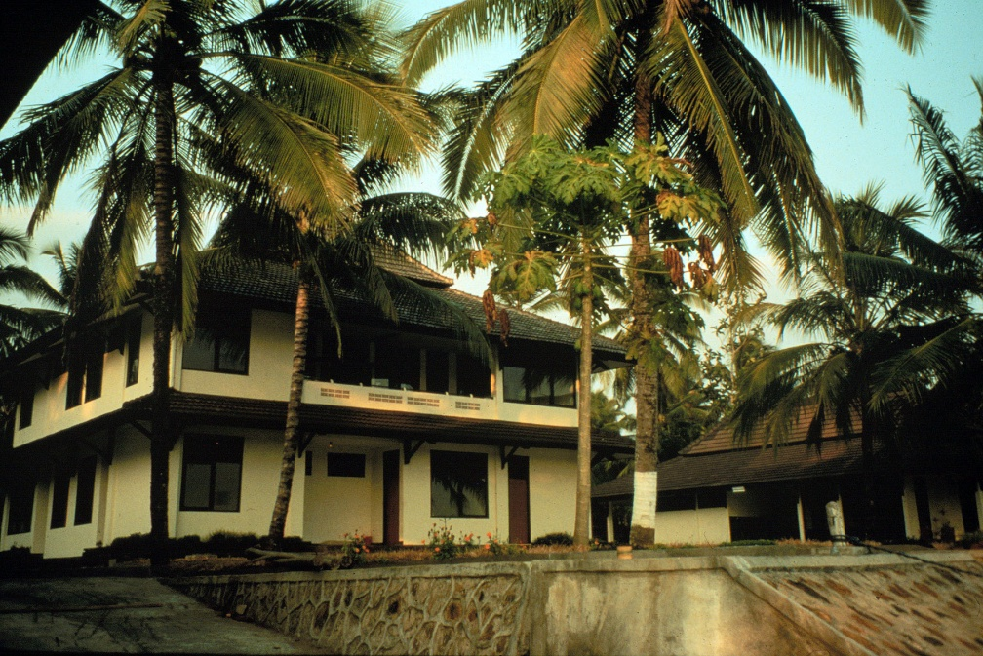
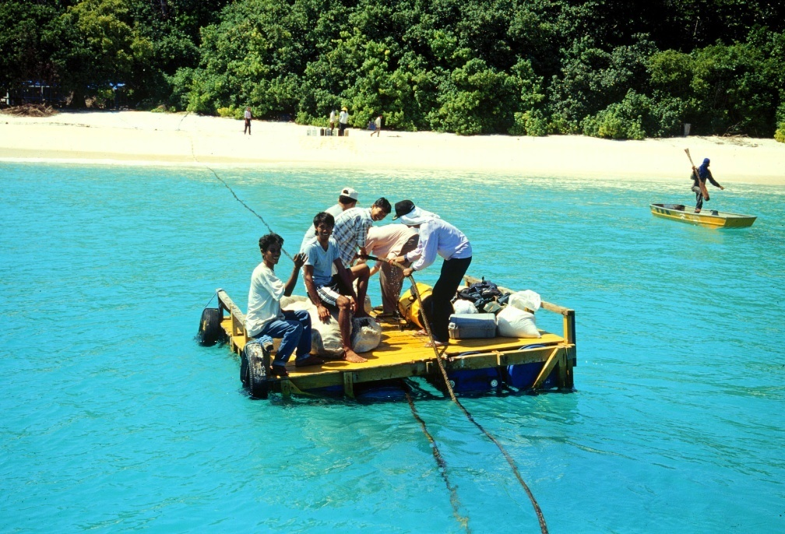
Considerations for selecting an island as a natural habitat breeding facility or sanctuary
Accessibility and Logistical Support

Slide 22
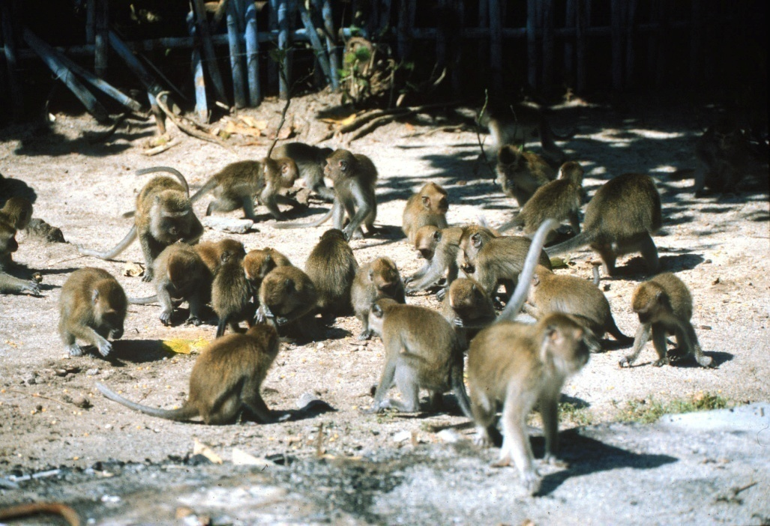
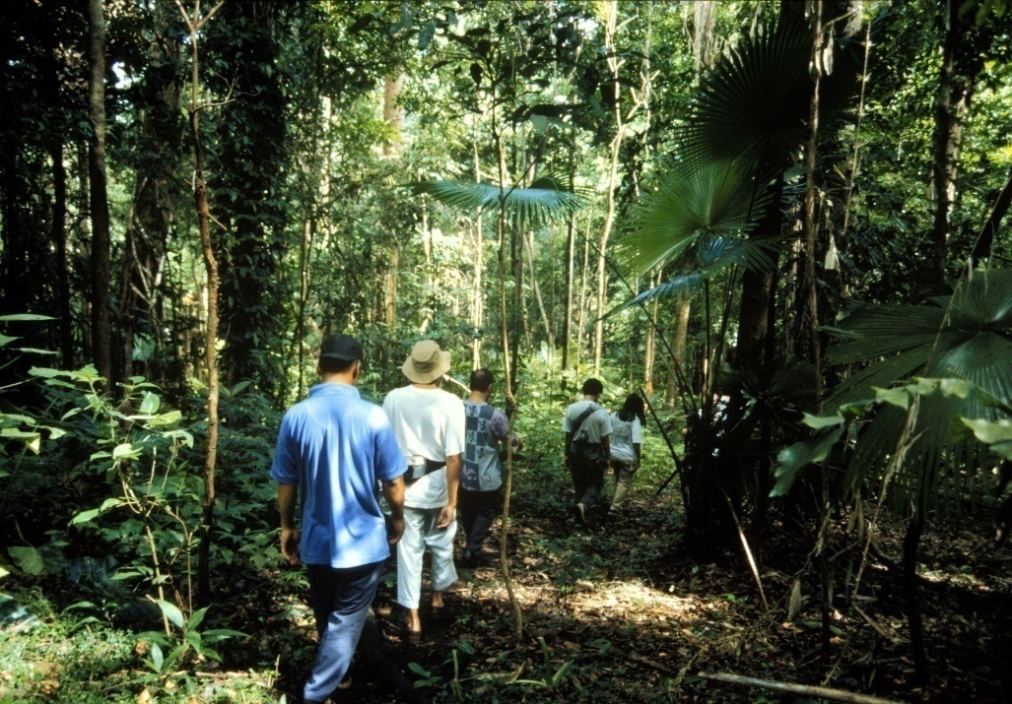
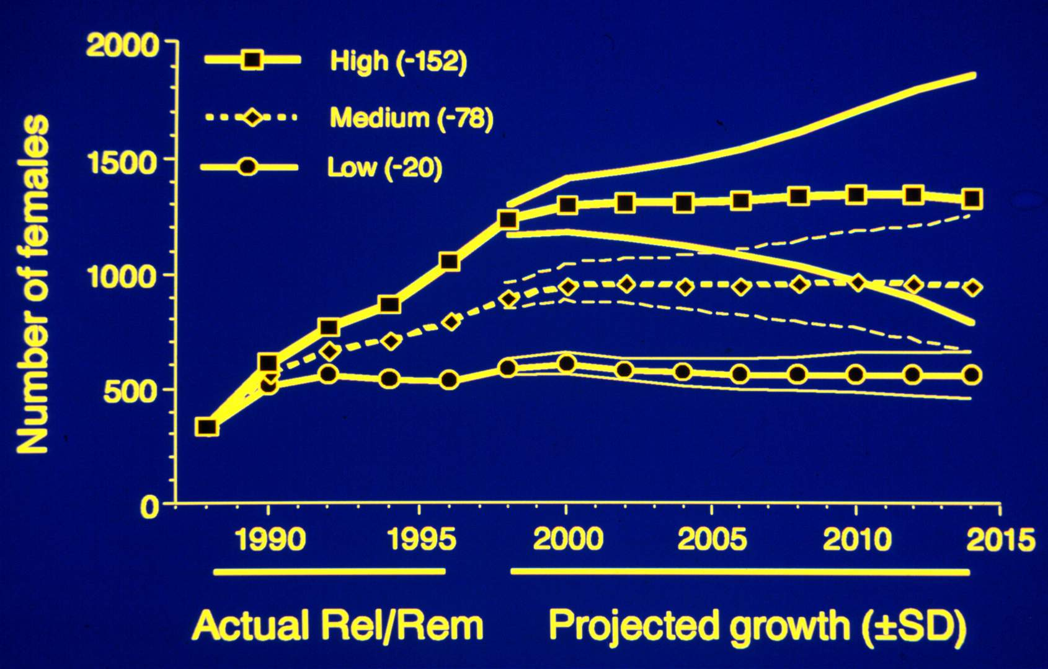
Considerations for selecting an island as a natural habitat breeding facility or sanctuary
Population Management

Slide 23
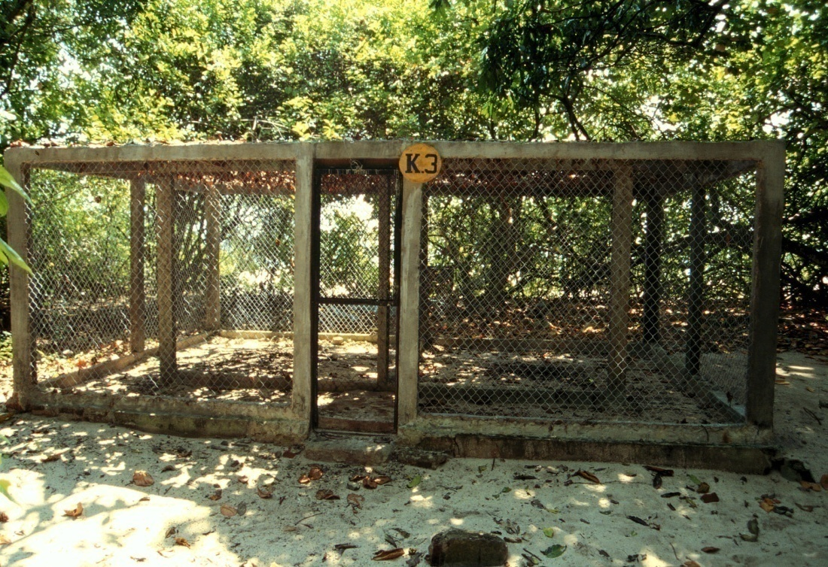
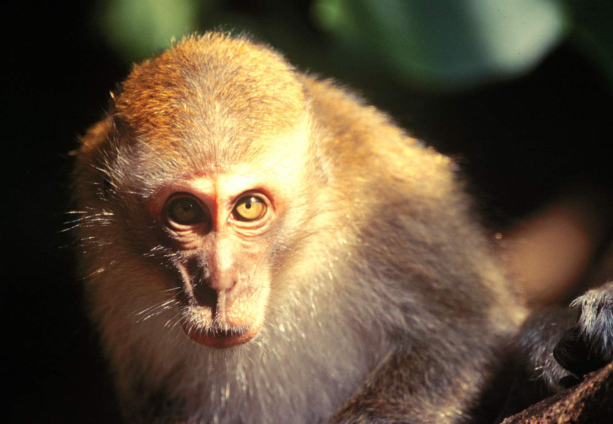
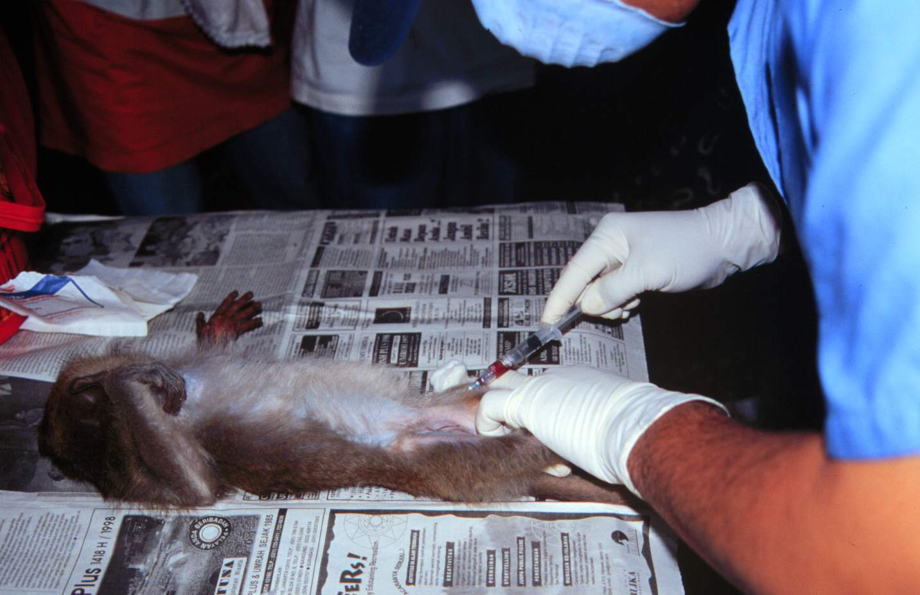
Considerations for selecting an island as a natural habitat breeding facility or sanctuary
Population Management

Slide 24
Summary
Small islands within a species’ natural range are well-suited for use as NHBFs. Managing an introduced population of primates within the natural boundary of a free-ranging, natural habitat provides particular benefit with respect to the primates’ health and well-being.
The same environment that provides a free-ranging, largely unprovisioned existence can often make determination of exact population size and demographic variables difficult. Therefore, special consideration must be given to establishing an effective population management plan.
The Tinjil Island NHBF represents an important resource option for maintaining the availability of primates for use in biomedical research in a manner that is conservationally sound.

